Slide 1
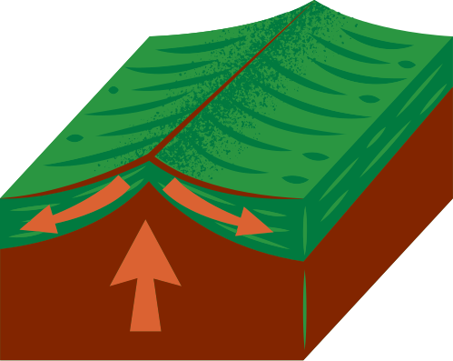
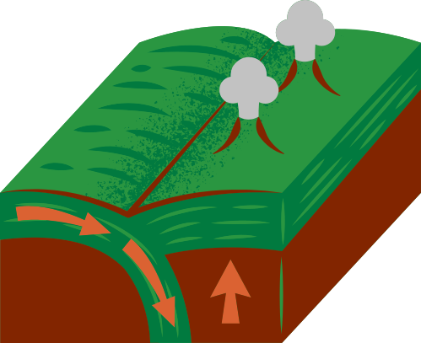
NATURAL DISASTERS
earthquakes
MADE BY;
K.S. RATHNAWEERA
ABISHREK VINOTH
A.S. WIJERATNE (NO HOME)
BROTHER ARJUN
R.N. GAMMAMPILA
B.L.I.P. FERNANDO
S.E. KUMARAGE
B

Slide 2
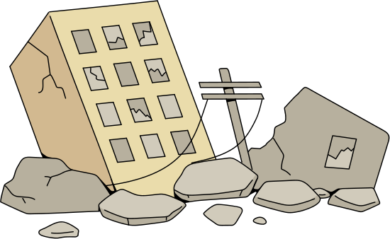
introduction to
earthquakes
An earthquake is a jolt or shoulder like movement of the Earth's surface.
Less violent earthquakes are known as tremors.
Earthquakes and Earth tremors are caused by releasing of the energy stored in the Earth's crust.

Slide 3
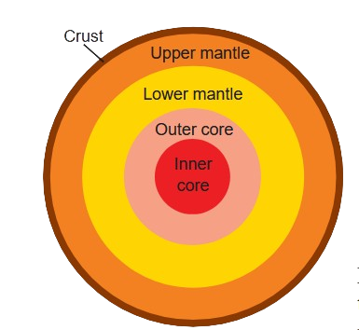
internal structure
of the earth
In order to understand how earthquakes are happening, we need to know about the
structure of the Earth. Here, we can see the internal structure of the Earth.
Crust
Mantle → ⓘ Upper Mantle
(ii) Lower Mantle
3. Core → ⓘ Outer Core
(ii) Inner Core

Slide 4
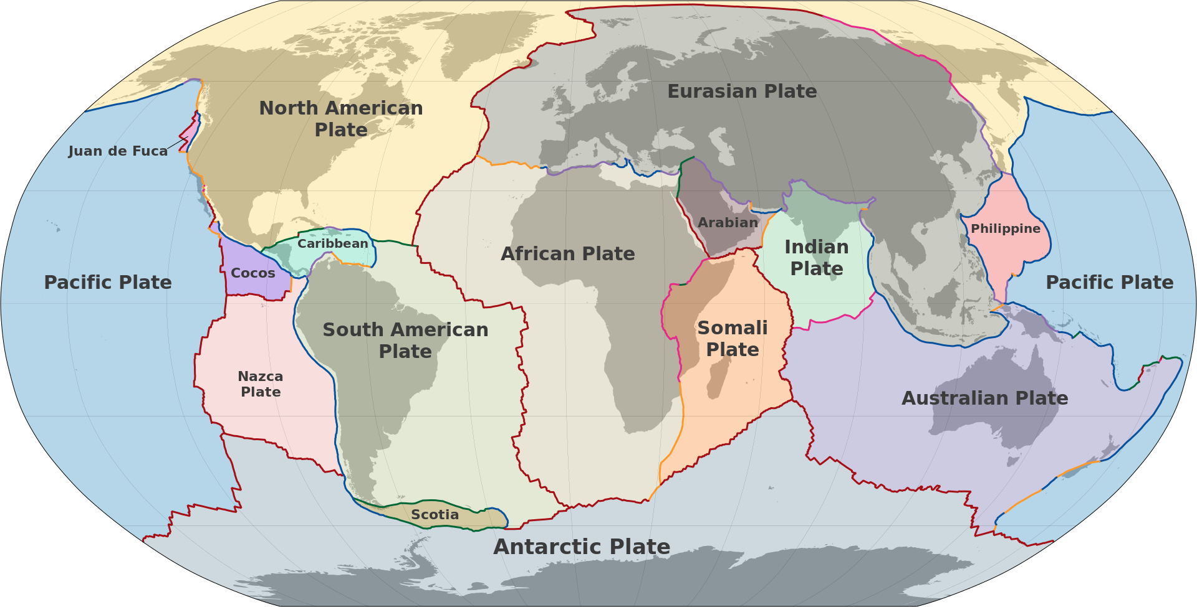
internal
structure
Evidences support the fact that the crust, the
topmost layer of the Earth is composed of a
number of tectonic plates which move relative to
one another. The Earth's crust consists of a few
large tectonic plates. They can be identified by
the following map.

Slide 5
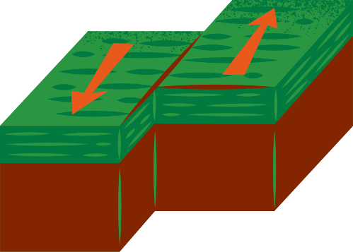
tectonic plates
There are 3 types of Tectonic Plates
Divergent Border
Convergent Border
slip
border
Plates move apart from each other
Two Plates collide with each other
Plates slide past each other

Slide 6
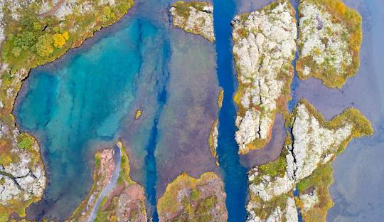

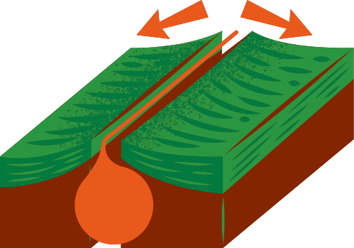
Divergent Plate Boundaries
Where two plates move away from each other.
Effects
Forms rift valleys (e.g., East African Rift)
Creates mid-ocean ridges (e.g., Mid-Atlantic Ridge)
Causes volcanic activity and shallow earthquakes.

Slide 7
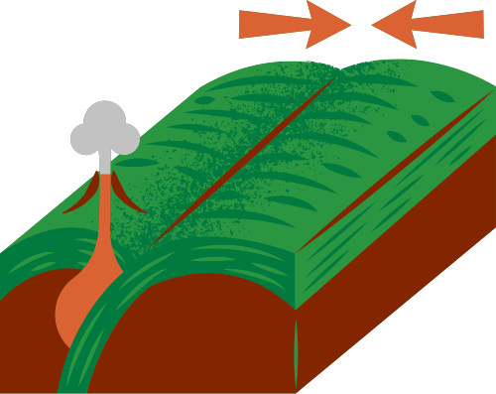
Convergent Plate Boundaries
Where two plates move toward each other.
Effects
Earthquakes
Volcanoes
Trenches

Slide 8
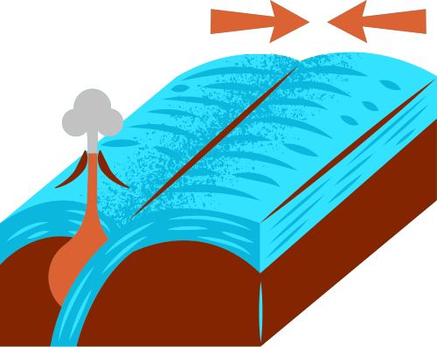
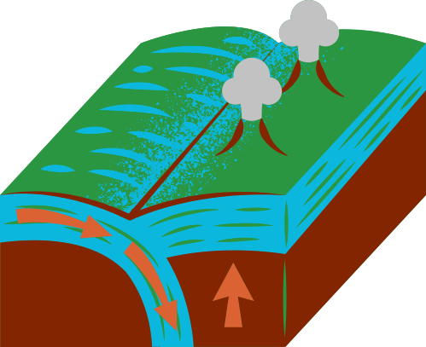
Convergent Plate Boundaries
Oceanic-Continental
Continental-Continental
Oceanic-Oceanic
Forms island arcs (e.g., Japan)
Forms volcanic mountains (e.g., Andes)
Forms fold mountains (e.g., Himalayas)

Slide 9
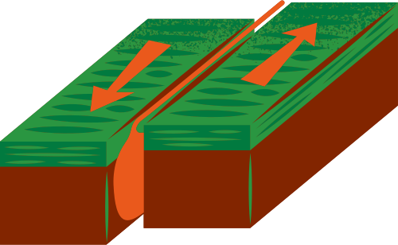
slip border
Where two plates slide past each other horizontally.
Effects
Causes earthquakes (e.g., San Andreas Fault in California)
No volcanic activity (no magma involved).

Slide 10
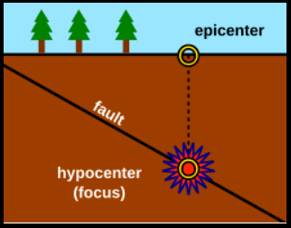
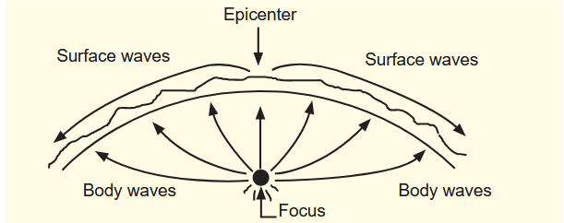
intensity of earthquakes
At the points at which the tectonic plates have colloid impact, the layers of rocks
bend. When the force exerted to bend them exceeds the yield point of the rocks, the
rocky layers break. This point of breakage is the focus of the earthquakes. The point
on Earth above the focus is the epicenter.

Slide 11
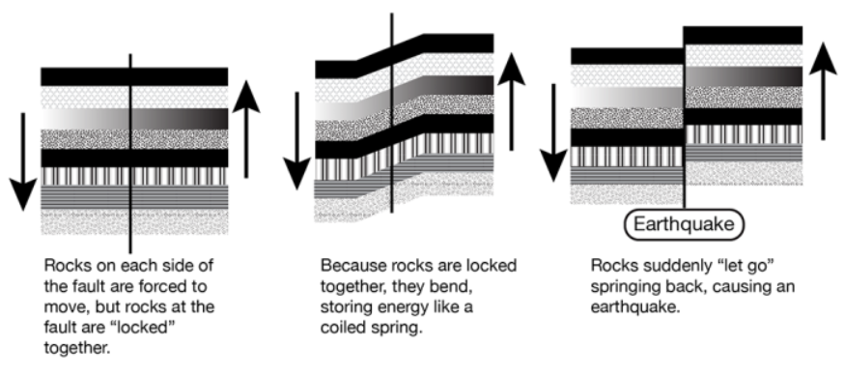
intensity of earthquakes

Slide 12
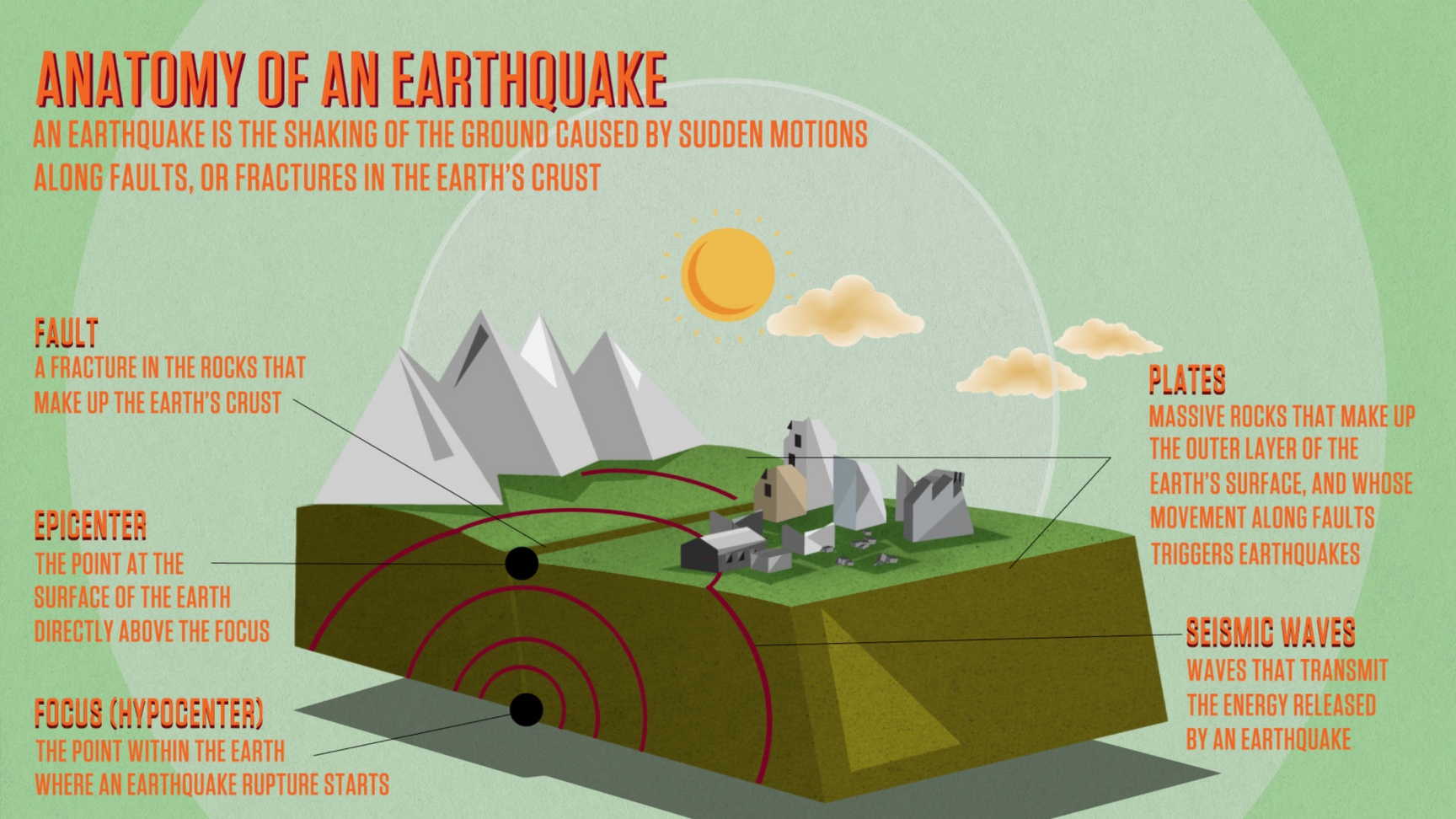
intensity of earthquakes

Slide 13
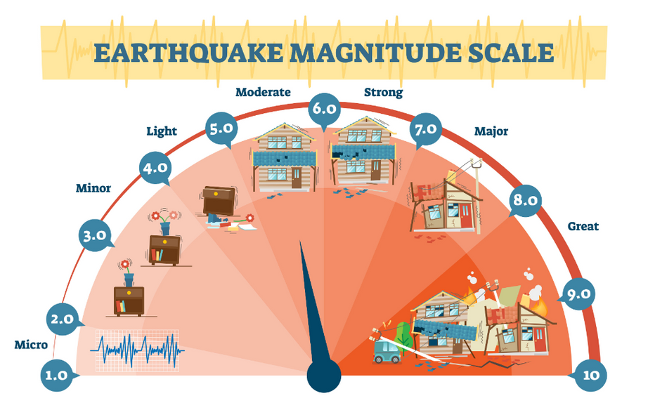
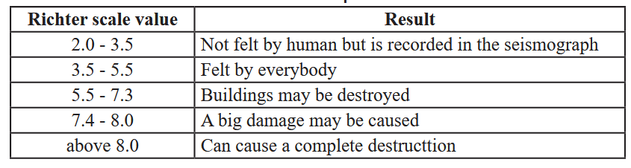
seismic waves
Seismic waves spread in all directions from the focus of an earthquake. These
waves convey energy along the surface of the Earth and also through the interior
of the Earth.
The strength of these seismic waves can be measured by the seismometers installed
at various places of the Earth. The apparatus which automatically records the
information related to seismic waves is called the seismograph.

Slide 14
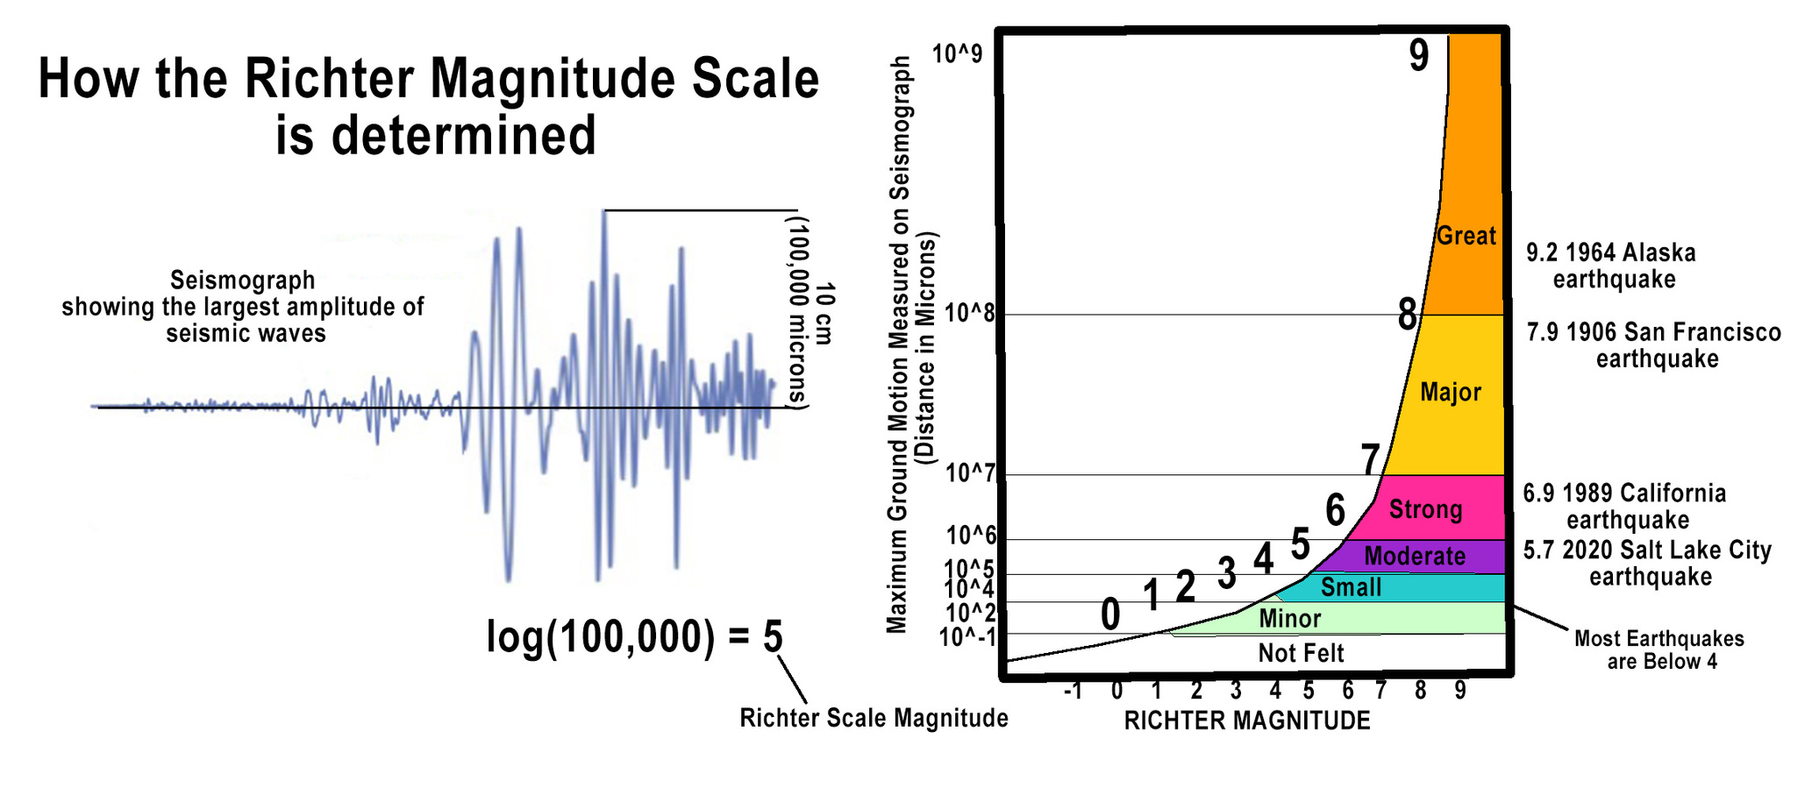
seismic waves

Slide 15
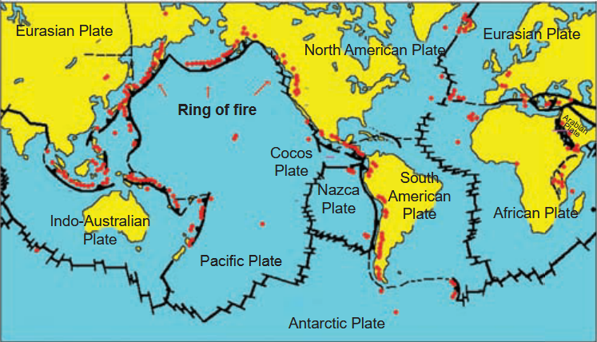
regions prone to earthquakes
From the above map, it may be clear to you that earthquakes have occurred mostly
in the borderland regions. Of them, too most of the earthquakes have broken out in
the region called 'Pacific Ring of Fire'. From the map it can be seen that, this region
is the border of the very large Pacific tectonic plate.

Slide 16
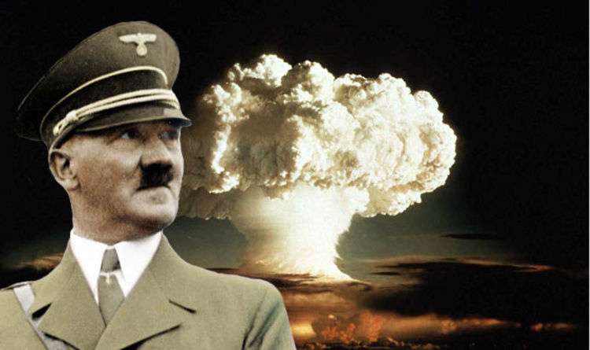

human activities
Recently, scientists have observed that, in addition to natural causes, some activities
of human could also be the reasons for earthquakes.
→ Testing nuclear weapons underneath Earth
-> Drilling Earth to great depths to mine oil and minerals
-> Erecting dams and constructing large water reservoirs
-> Constructing very large buildings of great heights and weights

Slide 17

THANK YOU!
me after a 6.7 magnitude earthquake is recorded

